Slide 1



Slide 2

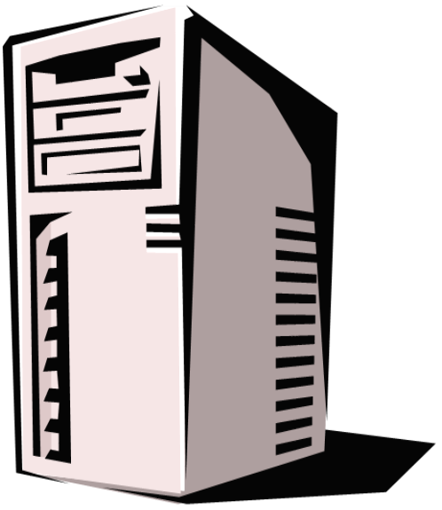
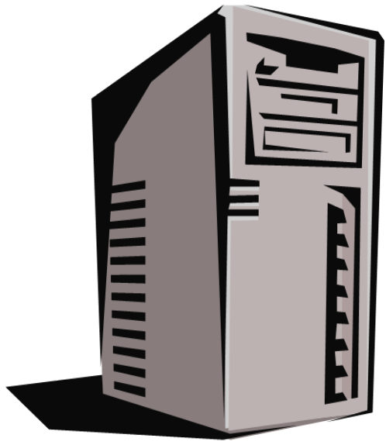
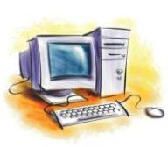

The TOWER contains
all of the parts of a computer

Slide 3

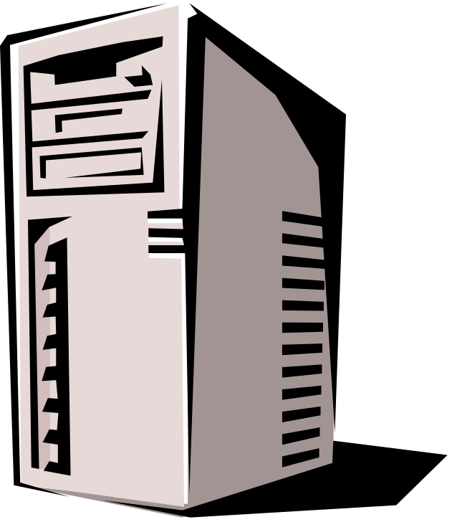
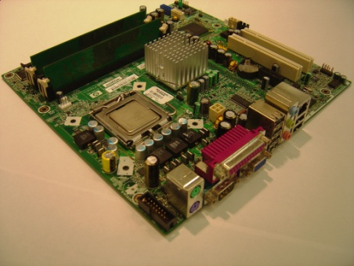
The MOTHERBOARD is the backbone of a computer – all other parts plug into it

Slide 4

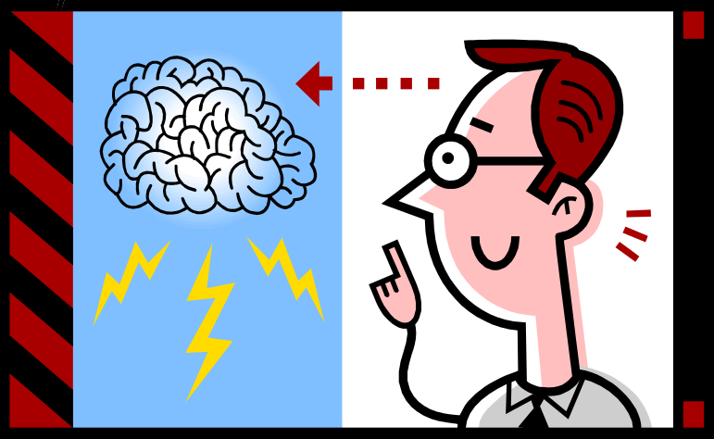
The CPU
(Central Processing Unit) is the brain of a computer – it tells the other parts what to do

Slide 5

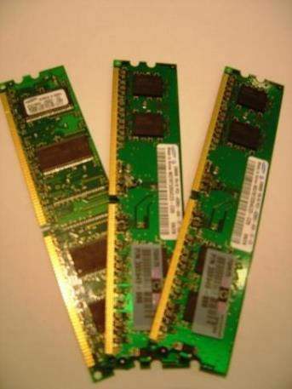
The RAM
(Random Access Memory) is the temporary memory of a computer

Slide 6

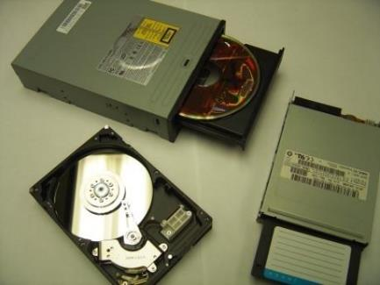
The ROM
(Random Only Memory)
is the permanent memory of a computer

Slide 7

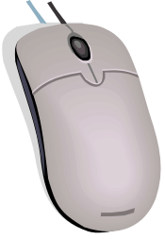

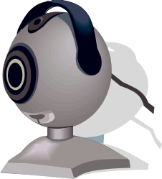
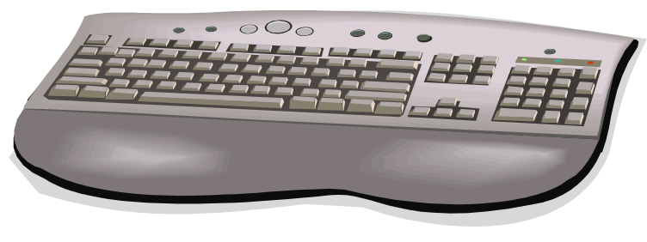
An INPUT DEVICE
lets you TALK TO the computer

Slide 8

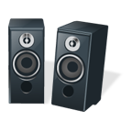



An OUTPUT DEVICE
lets the computer TALK TO you

